Slide 1
Randomized Algorithms CS648A
Lecture 5
Linearity of expectation
Pattern matching

Slide 2
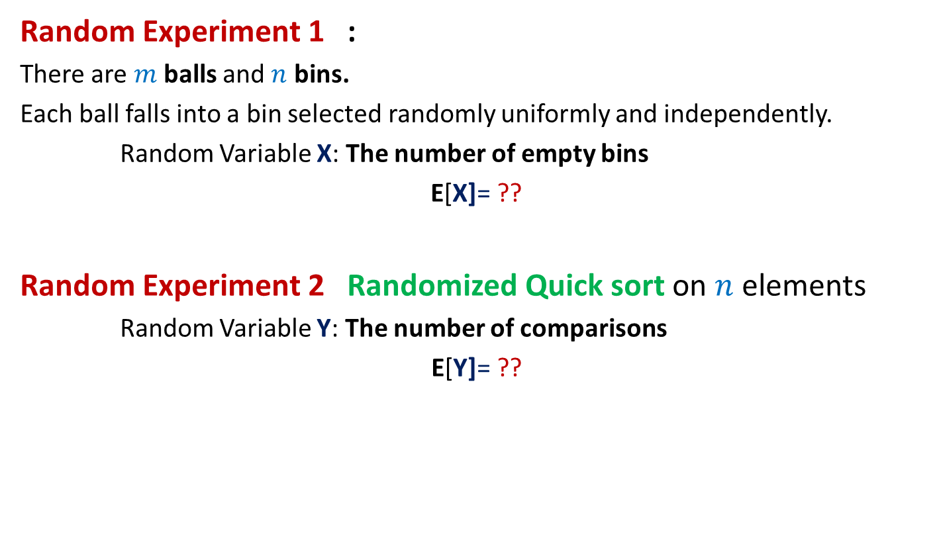
Can we solve these problems ?
Random Experiment 1 :
There are $m$balls and $n$ bins.
Each ball falls into a bin selected randomly uniformly and independently.
Random Variable X: The number of empty bins
E[X]= ??
Random Experiment 2 Randomized Quick sort on $n$ elements
Random Variable Y: The number of comparisons
E[Y]= ??

Slide 3

Randomized Quick Sort (number of comparisons)
Question : Y is random variable denoting the number of comparisons.
E[Y]= ??
Attempt 1: (based on definition of expectation)
E[Y] = $\sum_{i}{i∙\text{P}\text{(}\text{Y}\text{ =}i\text{)}}$
A recursion tree
associated with Randomized Quick Sort
We can not proceed from this point …☹

Slide 4

Since viewing the random experiment in its entirety looks so complex, let us take a microscopic view.
Balls into Bins (number of empty bins)
1 2 3 4 5 … $m−1 m$
1 2 3 … … $n$
Randomized Quick Sort (number of comparisons)

Slide 5

Balls into Bins (number of empty bins)
$$1 2 3 4 5 … m−1 m$$
Question: Let $X_{i}$ be a random variable defined as follows.
$X_{i}$ = $\left\{\begin{matrix}1 if ith bin is empty \\ 0 otherwise \end{matrix}\right.$
What is E[$X_{i}$] ?
Answer : E[$X_{i}$] = $1$ $∙$ $\text{P}\text{(}ith bin is empty\text{) }$ + $0$ $∙$ $\text{P}\text{(}ith bin is not empty\text{) }$
= $\text{P}\text{(}ith bin is empty\text{)}$
= ${(1−\frac{1}{n} )}^{m}$
1 2 3 … $i$ … $n$

Slide 6




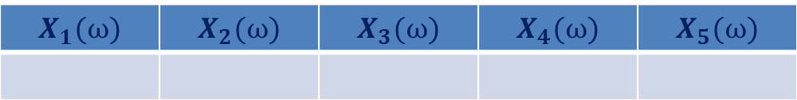
Balls into Bins (any relation between $X$ and $X_{i}$’s ?)
Consider any elementary event.
$X\left(ω\right)=2$
1 2 3 4 5 6
An elementary event
$$ω$$
number of empty bins
1 2 3 4 5
$$X_{1}(ω)$$ | $$X_{2}(ω)$$ | $$X_{3}(ω)$$ | $$X_{4}(ω)$$ | $$X_{5}(ω)$$
0
1
0
1
0
$X\left(ω\right)=$ $X_{1}\left(ω\right)+$ $X_{2}\left(ω\right)+$ $X_{3}\left(ω\right)+$ $X_{4}\left(ω\right)+$ $X_{5}\left(ω\right)$
for each $ω$ ϵ Ω

Slide 7

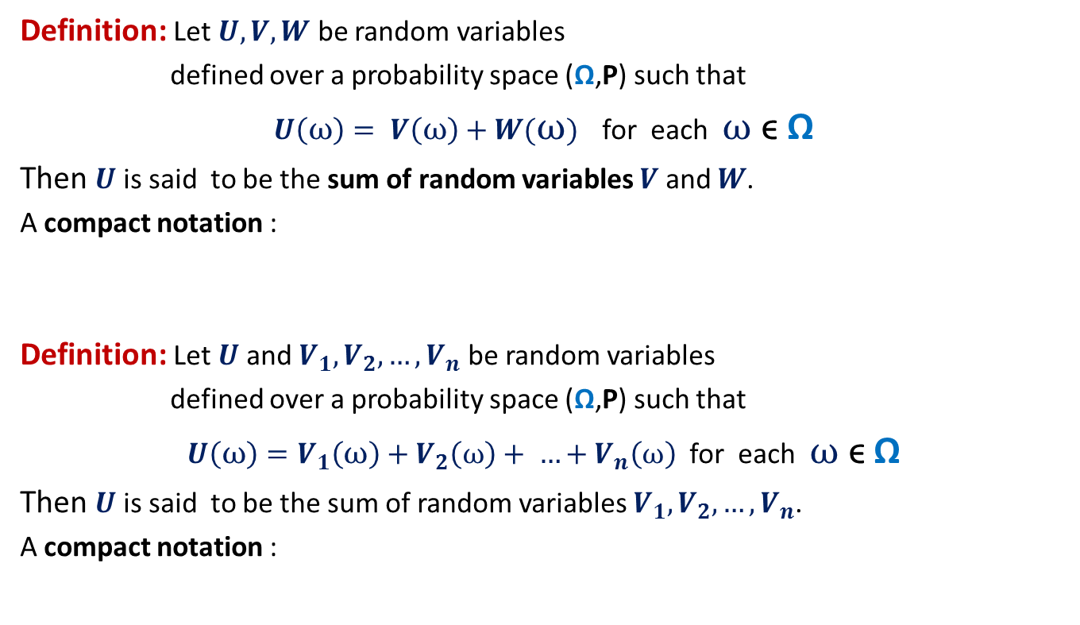

Sum of Random Variables
Definition: Let $U,V,W$ be random variables
defined over a probability space (Ω,P) such that
$U\left(ω\right)= V\left(ω\right)+W(ω)$ for each $ω$ ϵ Ω
Then $U$ is said to be the sum of random variables $V$ and $W$.
A compact notation :
Definition: Let $U$and $V_{1},V_{2},…,V_{n}$ be random variables
defined over a probability space (Ω,P) such that
$U\left(ω\right)=V_{1}\left(ω\right)+V_{2}\left(ω\right)+ …+V_{n}\left(ω\right)$ for each $ω$ ϵ Ω
Then $U$ is said to be the sum of random variables $V_{1},V_{2},…,V_{n}$.
A compact notation :
$$U=V+W$$
$$U=V_{1}+V_{2}+…+V_{n}$$

Slide 8

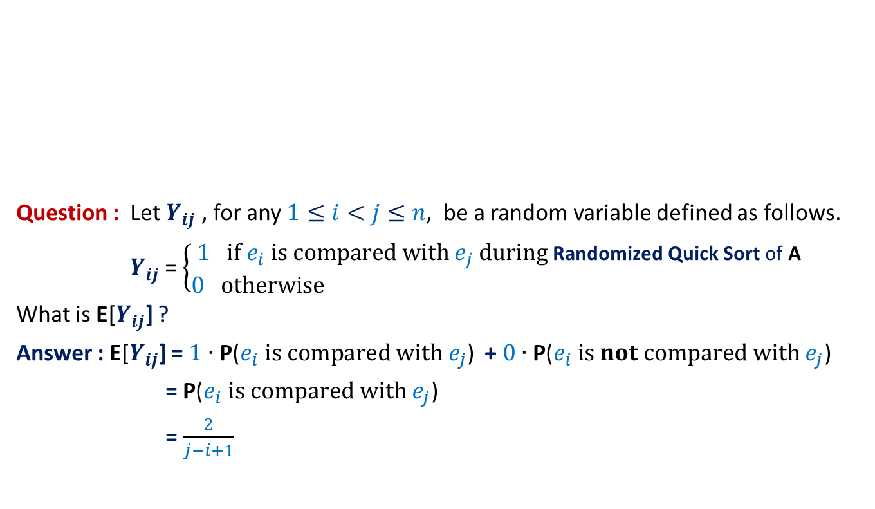
Randomized Quick Sort (number of comparisons)
Elements of A arranged in Increasing order of values
$$e_{i}$$
Question : Let $Y_{ij}$ , for any $1≤i<j≤n$, be a random variable defined as follows.
$Y_{ij}$ = $\left\{\begin{matrix}1 if e_{i} is compared with e_{j} during \text{Randomized} \text{Quick} \text{Sort} \text{of} \text{A} \\ 0 otherwise \end{matrix}\right.$
What is E[$Y_{ij}$] ?
Answer : E[$Y_{ij}$] = $1$ $∙$ $\text{P}\text{(}e_{i} is compared with e_{j}\text{)}$ + $0$ $∙$ $\text{P}\text{(}e_{i} is not compared with e_{j}\text{) }$
= $\text{P}\text{(}e_{i} is compared with e_{j}\text{)}$
= $\frac{2}{j−i+1}$

Slide 9
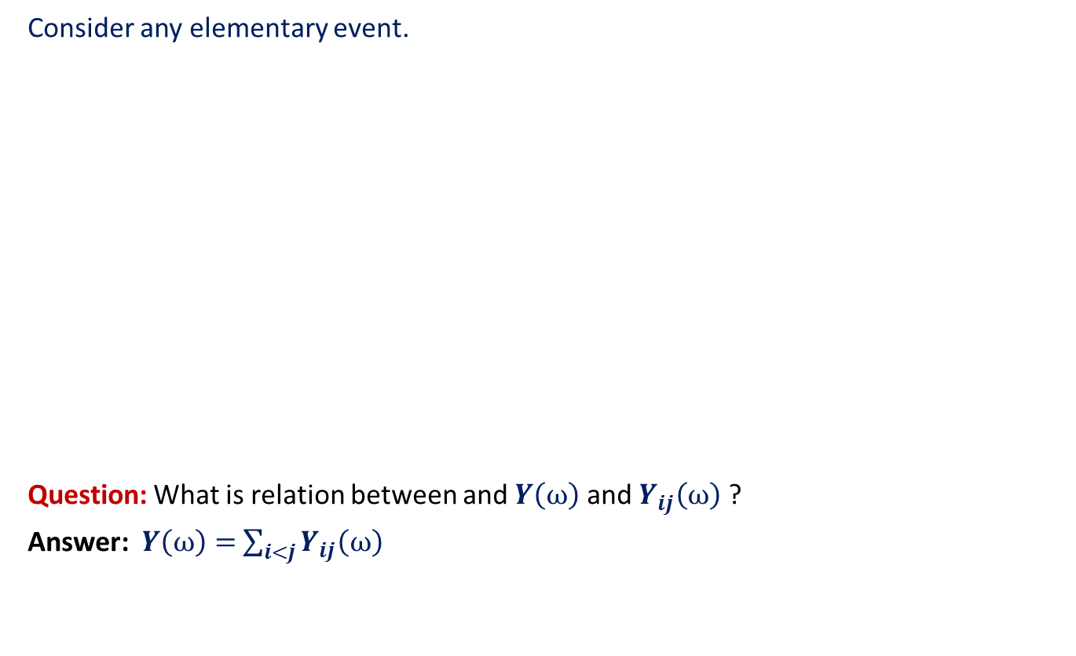



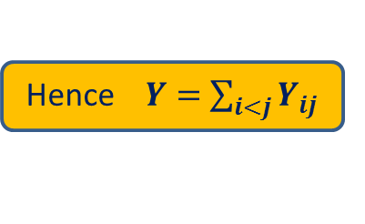
Randomized Quick Sort (any relation between $Y$ and $Y_{ij}$’s ?)
Consider any elementary event.
Question: What is relation between and $Y\left(ω\right)$ and $Y_{ij}\left(ω\right)$ ?
Answer: $Y\left(ω\right)=$ $\sum_{i<j}{Y_{ij}\left(ω\right)}$
Any elementary event
$$ω$$
$Y_{12}(ω){ Y}_{13}(ω)$ … $Y_{1n}(ω)$ $Y_{23}(ω)$ $Y_{24}(ω)$ … $Y_{n−1 n}(ω)$
1 0 … 0 1 1 … 0
for each $ω$ ϵ Ω
Hence $Y=$ $\sum_{i<j}{Y_{ij}}$
number of comparisons

Slide 10
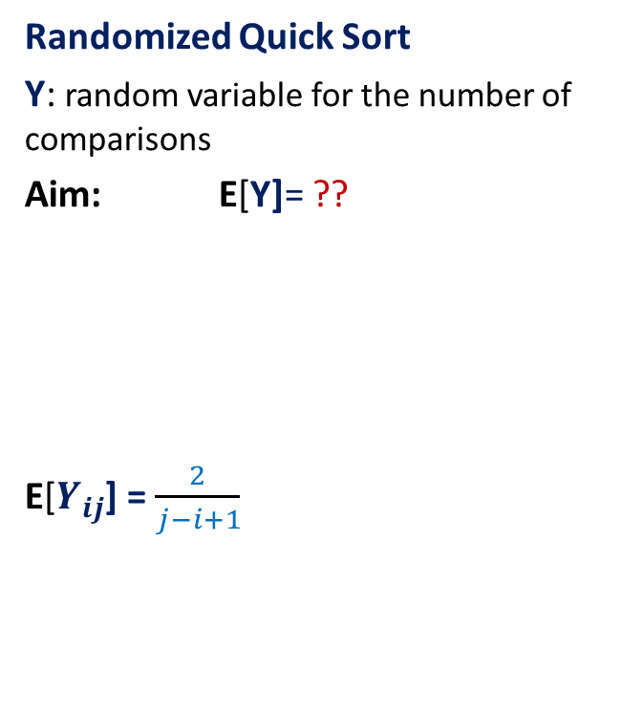

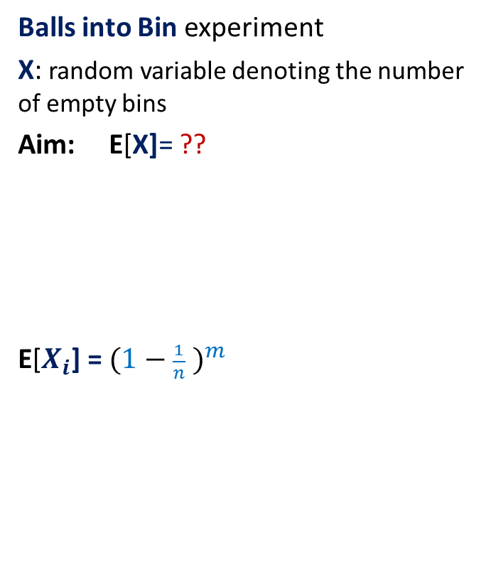
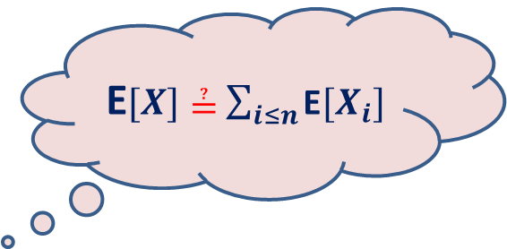
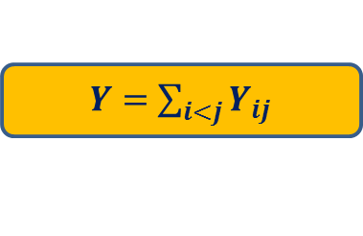
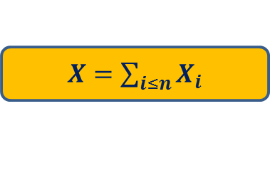
An interesting juncture
Balls into Bin experiment
X: random variable denoting the number of empty bins
Aim: E[X]= ??
E[$X_{i}$] = ${(1−\frac{1}{n} )}^{m}$
Randomized Quick Sort
Y: random variable for the number of comparisons
Aim: E[Y]= ??
E[$Y_{ij}$] = $\frac{2}{j−i+1}$
$X=$ $\sum_{i≤n}{X_{i}}$
$Y=$ $\sum_{i<j}{Y_{ij}}$
E$[X]≟$ $\sum_{i≤n}{\text{E}[X_{i}]}$
E$[Y]≟$ $\sum_{i<j}{\text{E}[Y_{ij}]}$

Slide 11
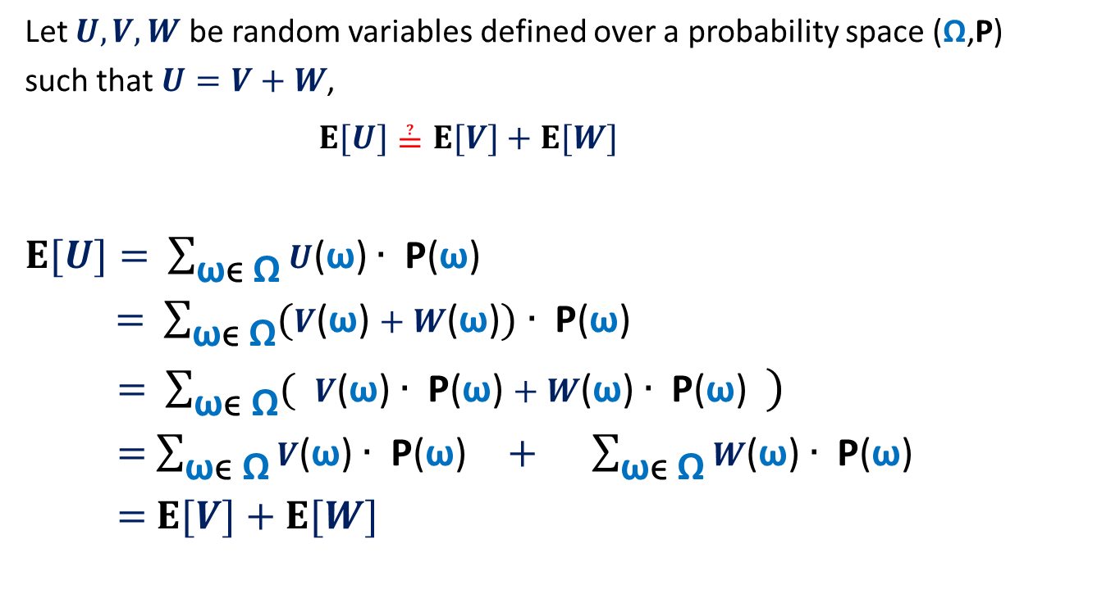
The main question?
Let $U,V,W$ be random variables defined over a probability space (Ω,P)
such that $U=V+W$,
$E[U]≟E[V]+E[W]$
$E[U]=$ $\sum_{\text{ω}\text{ϵ} \text{Ω}}{U\text{(}\text{ω}\text{)}∙ \text{P}\text{(}\text{ω}\text{)}}$
$=$ $\sum_{\text{ω}\text{ϵ} \text{Ω}}{(V\text{(}\text{ω}\text{)}+W\text{(}\text{ω}\text{)})∙ \text{P}\text{(}\text{ω}\text{)}}$
$=$ $\sum_{\text{ω}\text{ϵ} \text{Ω}}{( V\text{(}\text{ω}\text{)}∙ \text{P}\text{(}\text{ω}\text{)}+W\text{(}\text{ω}\text{)}∙ \text{P}\text{(}\text{ω}\text{)} )}$
$=$ $\sum_{\text{ω}\text{ϵ} \text{Ω}}{V\text{(}\text{ω}\text{)}∙ \text{P}\text{(}\text{ω}\text{)}} + \sum_{\text{ω}\text{ϵ} \text{Ω}}{W\text{(}\text{ω}\text{)}∙ \text{P}\text{(}\text{ω}\text{) }}$
$=$ $E[V]+E[W]$

Slide 12

Balls into Bins (number of empty bins)
1 2 3 4 5 … m-1 m
$X$ : random variable denoting the number of empty bins.
$X=$ $\sum_{i≤n}{X_{i}}$
Using Linearity of Expectation
$E$[$X$] $=\sum_{i≤n}{E[X_{i}]}$
$=\sum_{i≤n}{{(1−\frac{1}{n} )}^{m}}$
$=$ $n{(1−\frac{1}{n} )}^{m}$
$=$ $n/e$ for $m=n$
1 2 3 … … n

Slide 13
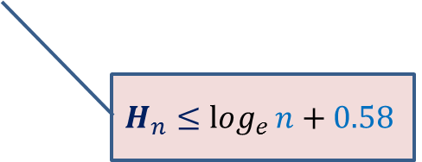
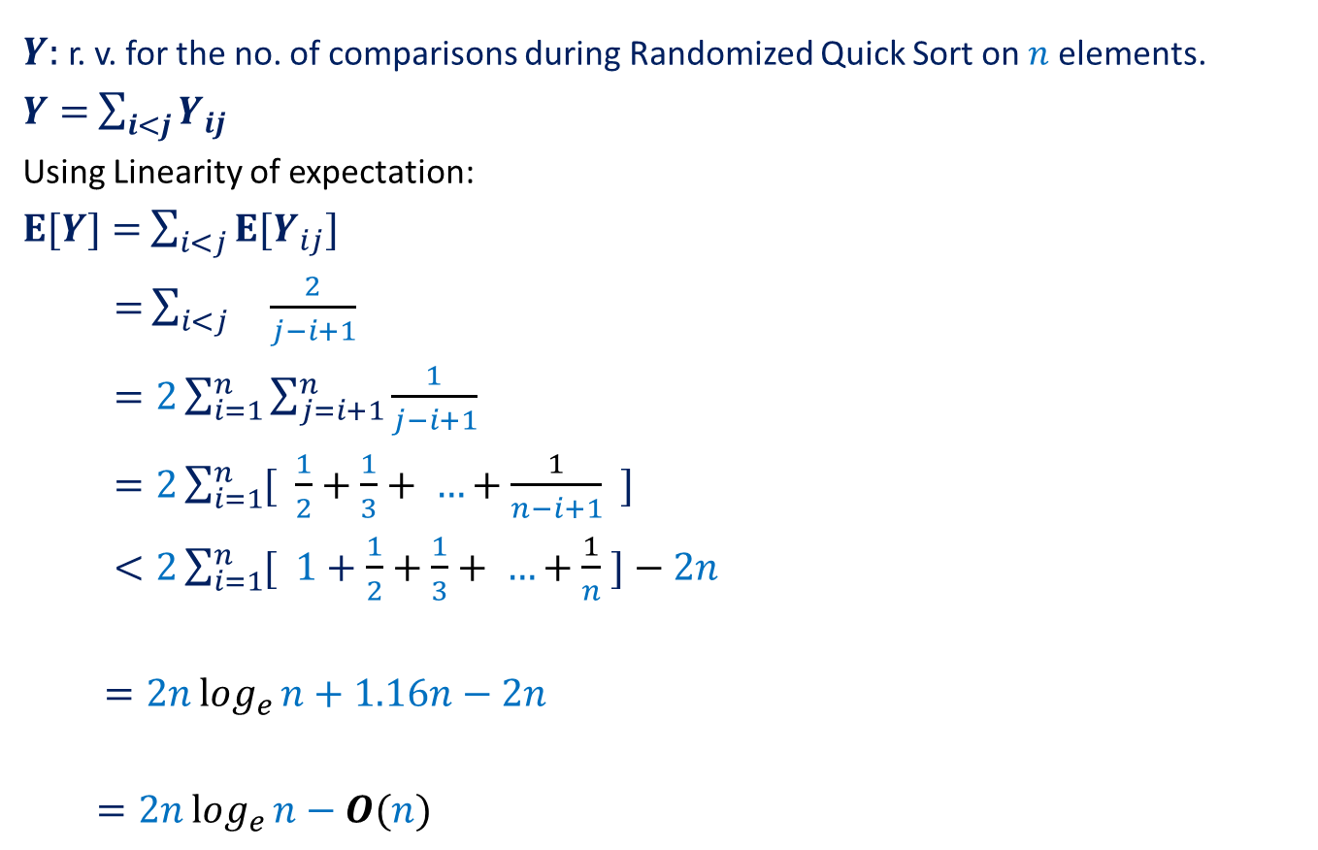
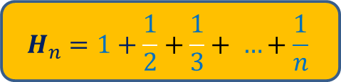
Randomized Quick Sort (number of comparisons)
$Y$: r. v. for the no. of comparisons during Randomized Quick Sort on $n$ elements.
$Y=$ $\sum_{i<j}{Y_{ij}}$
Using Linearity of expectation:
$E[Y]=$ $\sum_{i<j}{{E[Y}_{ij}]}$
$=$ $\sum_{i<j}{ \frac{2}{j−i+1}}$
$=2\sum_{i=1}^{n}{\sum_{j=i+1}^{n}{\frac{1}{j−i+1}}}$
$=2\sum_{i=1}^{n}{[ \frac{1}{2}+\frac{1}{3}+ …+\frac{1}{n−i+1} ]}$
$<2\sum_{i=1}^{n}{[ 1+\frac{1}{2}+\frac{1}{3}+ …+\frac{1}{n} ]}−2n$
$=2nlog_{e}{n}+1.16n−2n$
$=2nlog_{e}{n}−O(n)$
$$H_{n}=1+\frac{1}{2}+\frac{1}{3}+ …+\frac{1}{n}$$
$$H_{n}≤log_{e}{n}+0.58$$

Slide 14
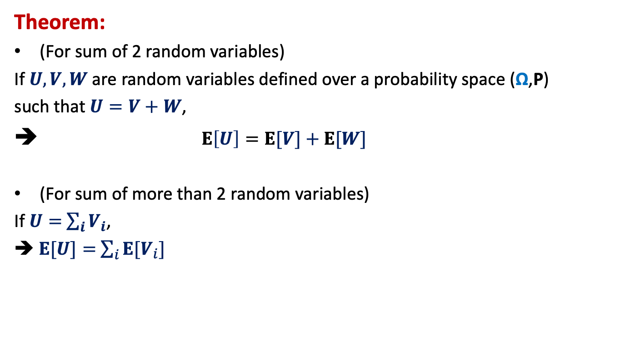
Linearity of Expectation
Theorem:
(For sum of 2 random variables)
If $U,V,W$ are random variables defined over a probability space (Ω,P)
such that $U=V+W$,
➔ $E\left[U\right]=E[V]+E[W]$
(For sum of more than 2 random variables)
If $U=$ $\sum_{i}{V_{i}}$,
➔$E[U]=$ $\sum_{i}{{E[V}_{i}]}$

Slide 15
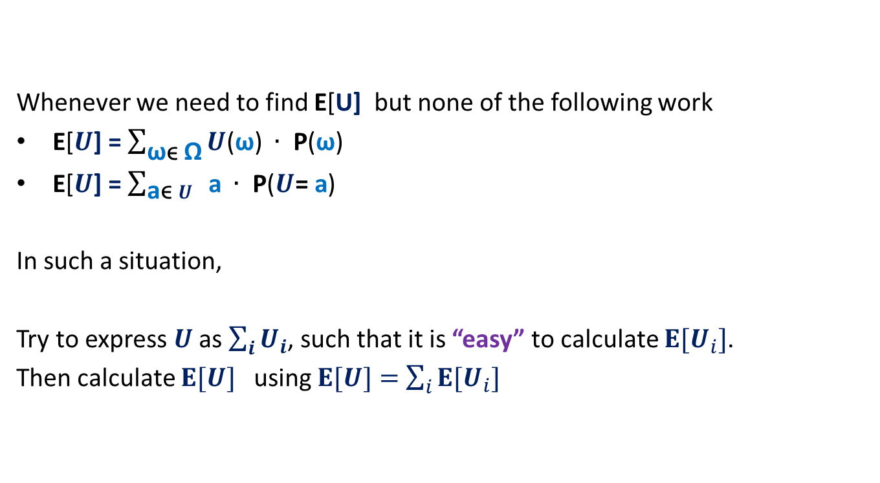
Where to use Linearity of expectation ?
Whenever we need to find E[U] but none of the following work
E[$U$] = $\sum_{\text{ω}\text{ϵ} \text{Ω}}{U\text{(}\text{ω}\text{)} ∙ \text{P}\text{(}\text{ω}\text{)}}$
E[$U$] = $\sum_{\text{a}\text{ϵ} U}{ \text{a} ∙ \text{P}\text{(}U\text{= }\text{a}\text{)}}$
In such a situation,
Try to express $U$ as $\sum_{i}{U_{i}}$, such that it is “easy” to calculate ${E[U}_{i}]$.
Then calculate $E[U]$ using $E[U]=$ $\sum_{i}{{E[U}_{i}]}$

Slide 16

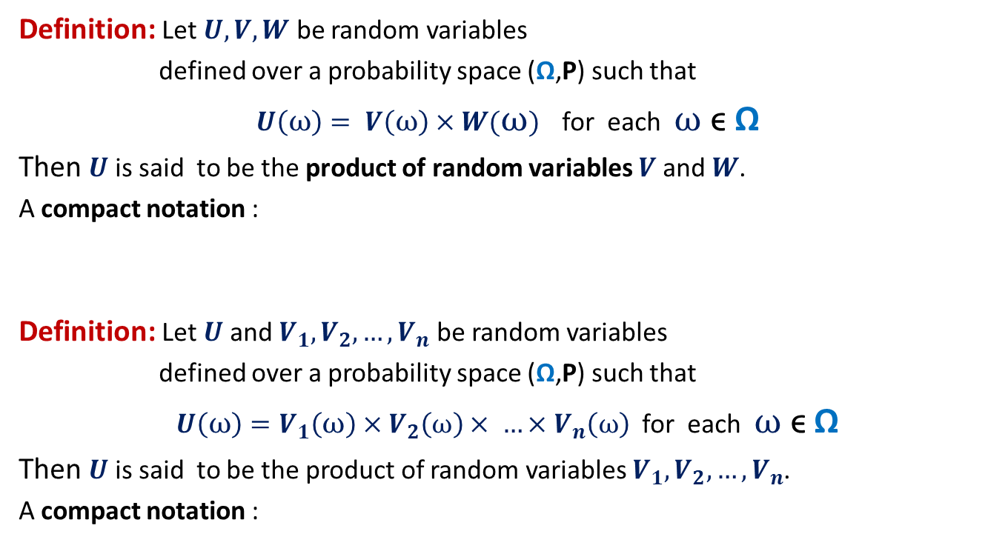

Product of Random Variables
Definition: Let $U,V,W$ be random variables
defined over a probability space (Ω,P) such that
$U\left(ω\right)= V\left(ω\right)×W(ω)$ for each $ω$ ϵ Ω
Then $U$ is said to be the product of random variables $V$ and $W$.
A compact notation :
Definition: Let $U$and $V_{1},V_{2},…,V_{n}$ be random variables
defined over a probability space (Ω,P) such that
$U\left(ω\right)=V_{1}\left(ω\right)×V_{2}\left(ω\right)× …×V_{n}\left(ω\right)$ for each $ω$ ϵ Ω
Then $U$ is said to be the product of random variables $V_{1},V_{2},…,V_{n}$.
A compact notation :
$$U=V×W$$
$$U=V_{1}×V_{2}×…×V_{n}$$

Slide 17



A question
➔ $E\left[U\right]=E[V]+E[W]$ $E\left[U\right] ? E\left[V\right]×E[W]$
$$U=V+W$$
$$U=V×W$$

Slide 18
Fingerprinting Application 2
Pattern matching

Slide 19

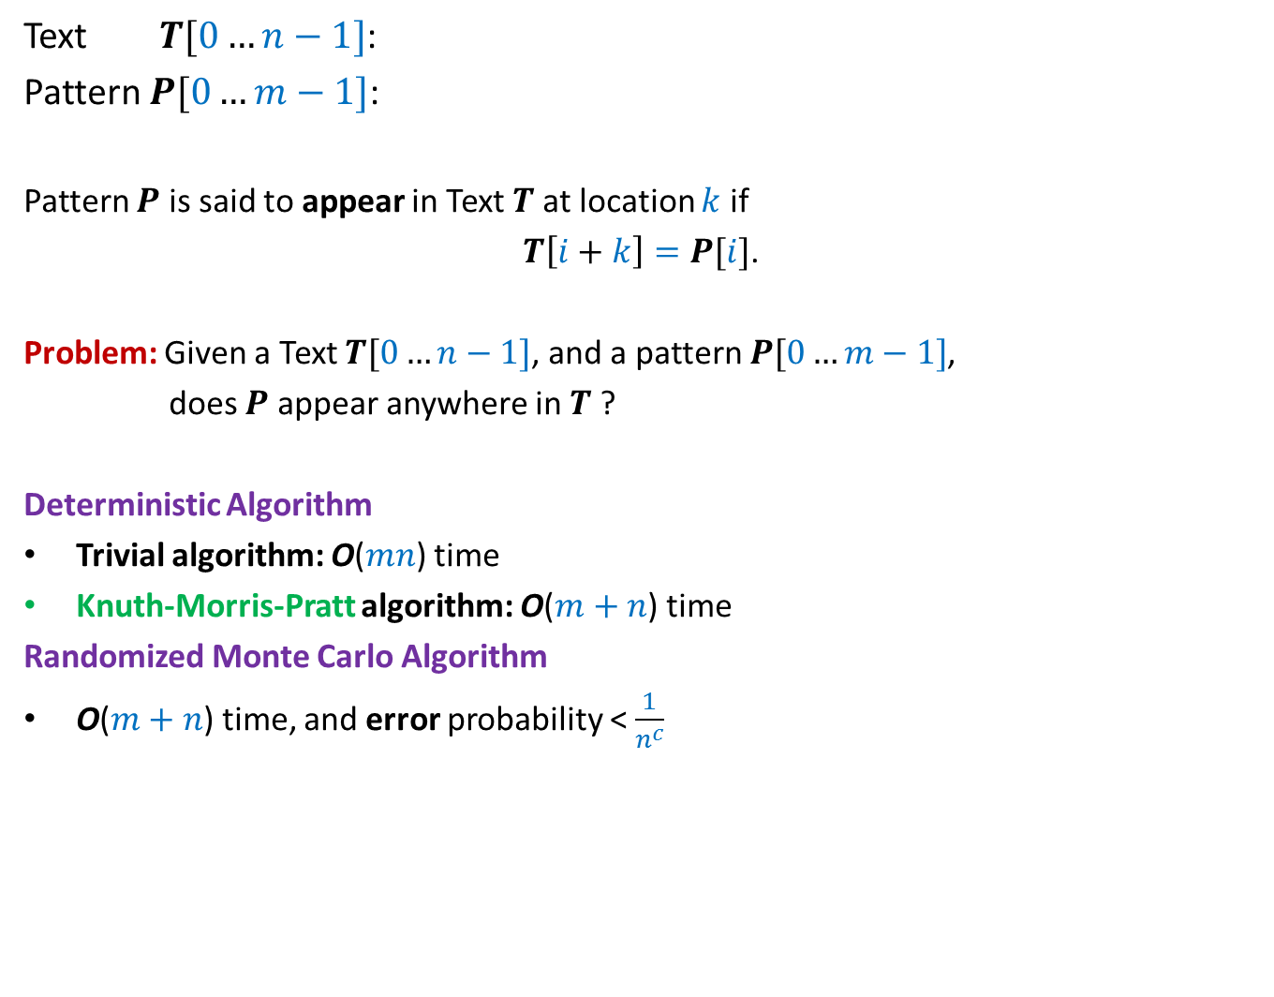
17
Text $T[0…n−1]$:
Pattern $P[0…m−1]$:
Pattern $P$ is said to appear in Text $T$at location $k$ if
$T\left[i+k\right]=P[i]$.
Problem: Given a Text $T[0…n−1]$, and a pattern $P[0…m−1]$,
does $P$ appear anywhere in $T$ ?
Deterministic Algorithm
Trivial algorithm: O($mn$) time
Knuth-Morris-Pratt algorithm: O($m+n$) time
Randomized Monte Carlo Algorithm
O($m+n$) time, and error probability < $\frac{1}{n^{c}}$
100101100110001101111010101110101010111010000101
011110101011101
for all $0≤i<m$,

Slide 20
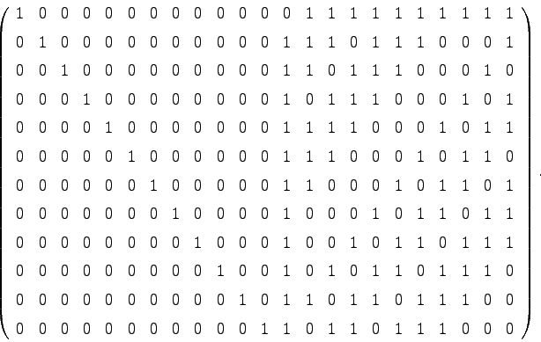

Motivation
Simplicity, real time implementation, streaming environment
Extension to 2-dimensions
Converting Monte Carlo to Las Vegas algorithm
1 1 0
1 1 0 1
1 0 1 1
1 1 1 1
m⨯m
n⨯n
O($n^{2}+m^{2}$) time algorithm

Slide 21
Randomized Algorithm for pattern Matching

Slide 22
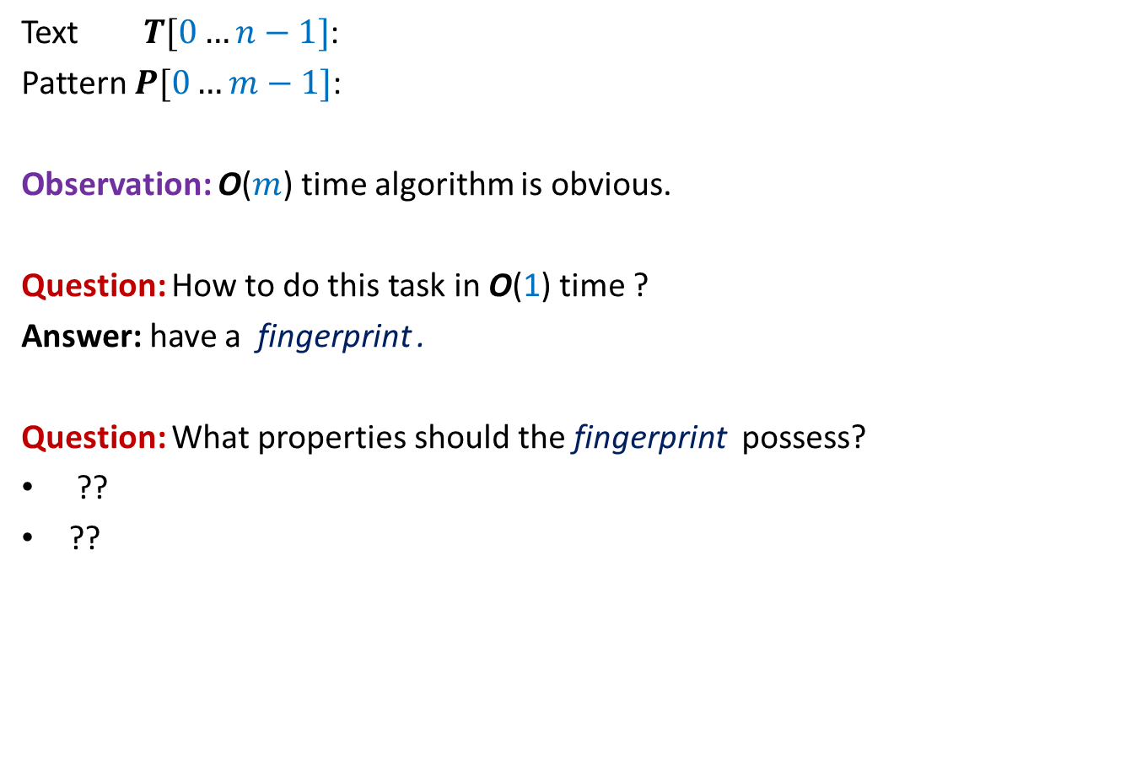


Checking if$P$appears in Text $T$at location $k$
$$k$$
Text $T[0…n−1]$:
Pattern $P[0…m−1]$:
Observation: O($m$) time algorithm is obvious.
Question: How to do this task in O(1) time ?
Answer: have a fingerprint .
Question: What properties should the fingerprint possess?
??
??
100101100110001101111010101010101010111010000101
0111101110110101
Small size
Efficiently computable

Slide 23

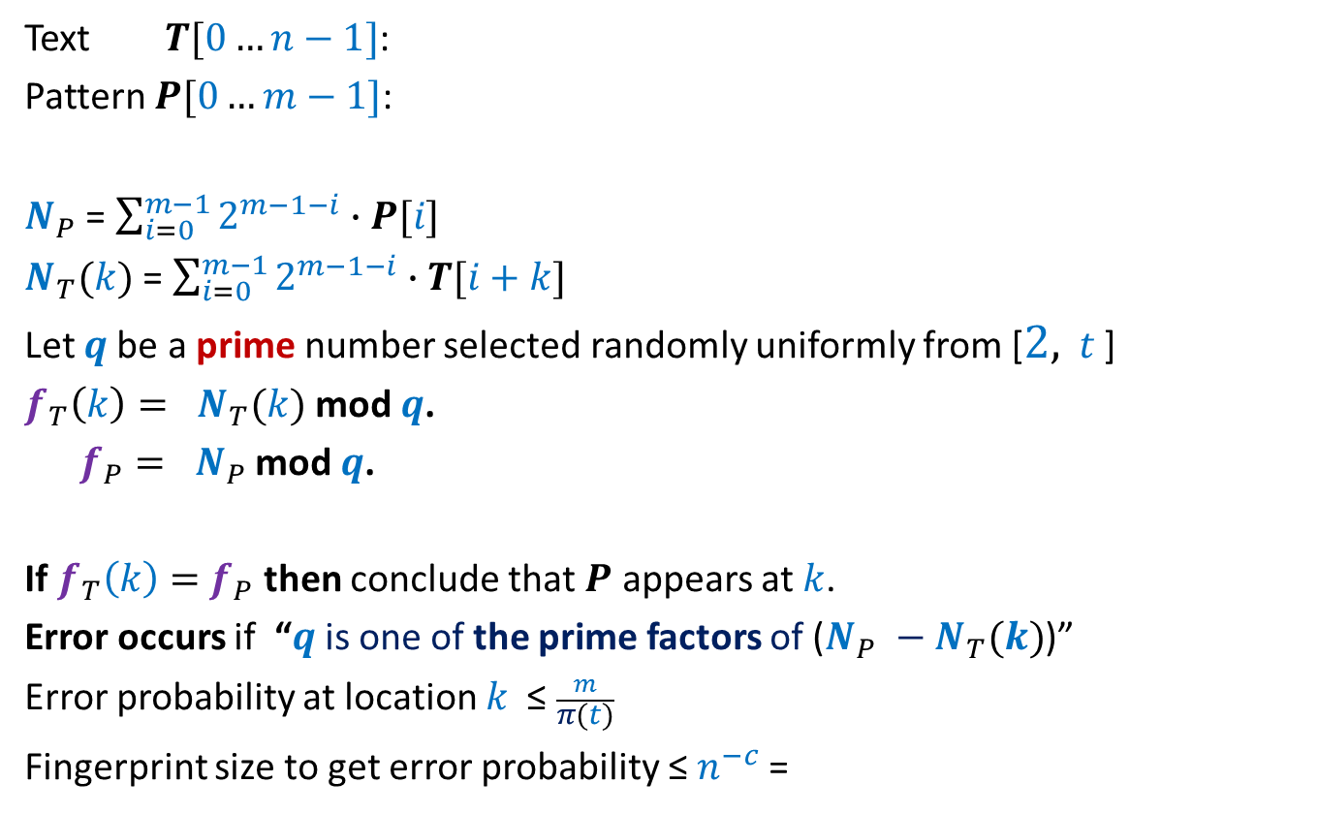


Checking if$P$appears in Text $T$at location $k$
$$k$$
Text $T[0…n−1]$:
Pattern $P[0…m−1]$:
$N_{P}$ = $\sum_{i=0}^{m−1}{2^{m−1−i}∙P[i]}$
$N_{T}(k)$ = $\sum_{i=0}^{m−1}{2^{m−1−i}∙T[i+k]}$
Let $q$be a prime number selected randomly uniformly from [$2,$ $t$ ]
$f_{T}\left(k\right)= N_{T}(k)$ mod $q$.
$f_{P}= N_{P}$ mod $q$.
If $f_{T}\left(k\right)=$ $f_{P}$ then conclude that $P$ appears at $k$.
Error occurs if “$q$is one of the prime factors of ($N_{P} −N_{T}(k)$)”
Error probability at location $k$ ≤ $\frac{m}{π(t)}$
Fingerprint size to get error probability ≤ $n^{−c}$=
100101100110001101111010101010101010111010000101
0111101110110101
<$\frac{1}{n^{c}}$
for $t$ = $4n^{c}m log nm$
O($\log{m}+\log{n}$) bits

Slide 24
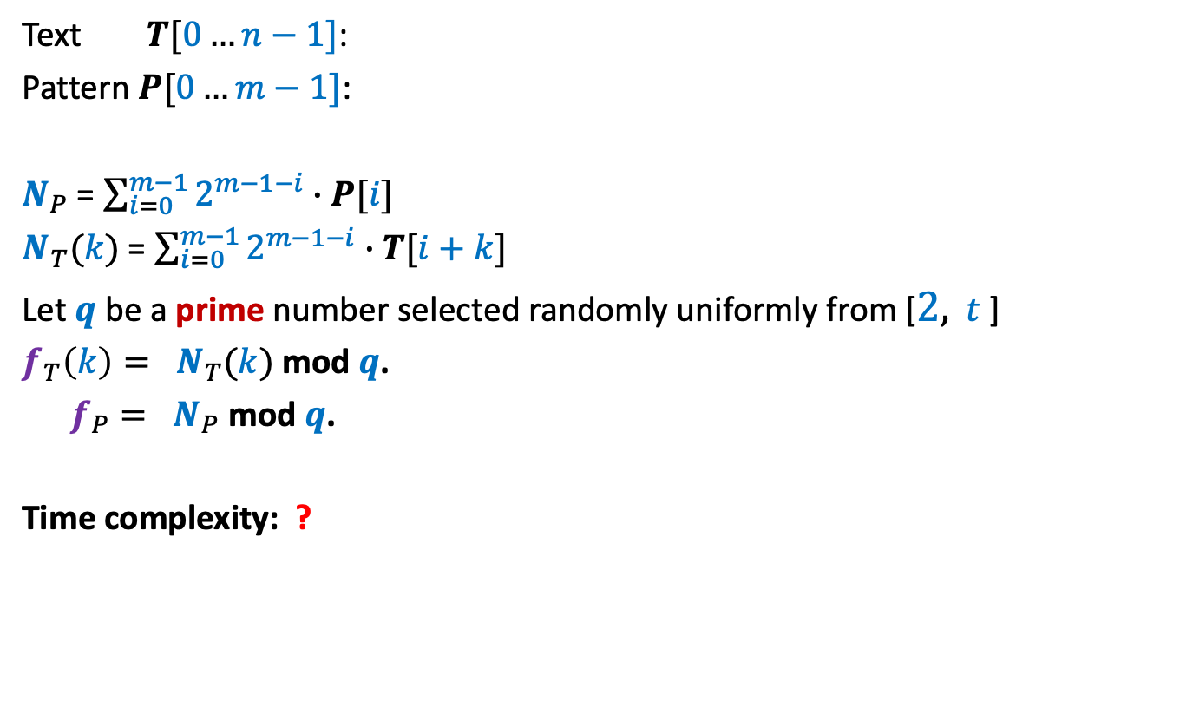
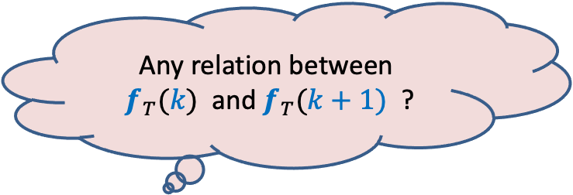

Checking if$P$appears in Text $T$at location $k$
$$k$$
Text $T[0…n−1]$:
Pattern $P[0…m−1]$:
$N_{P}$ = $\sum_{i=0}^{m−1}{2^{m−1−i}∙P[i]}$
$N_{T}(k)$ = $\sum_{i=0}^{m−1}{2^{m−1−i}∙T[i+k]}$
Let $q$be a prime number selected randomly uniformly from [$2,$ $t$ ]
$f_{T}\left(k\right)= N_{T}(k)$ mod $q$.
$f_{P}= N_{P}$ mod $q$.
Time complexity: ?
100101100110001101111010101010101010111010000101
0111101110110101
$Θ(m)$ since $N_{T}(k)$ has $m$ bits.
Any relation between
$f_{T}(k)$ and $f_{T}(k+1)$ ?
Homework

Slide 25
A problem in distributed environment

Slide 26
There is no centralized unit.
Each client only knows the address of each server.
A client has no way to communicate/coordinate with other clients.
Aim:
A distributed protocol to assign clients to servers
so that the maximum load is minimized.
n servers
A central unit to assign clients to servers
n clients

Slide 27
Client-Server Problem in Distributed Environment
A distributed protocol:
Each client selects a server
randomly uniformly and
independent of other clients,
and approaches it for its job.
n servers
n clients
What will be maximum load with high probability ?

Slide 28
the Union Theorem

Slide 29
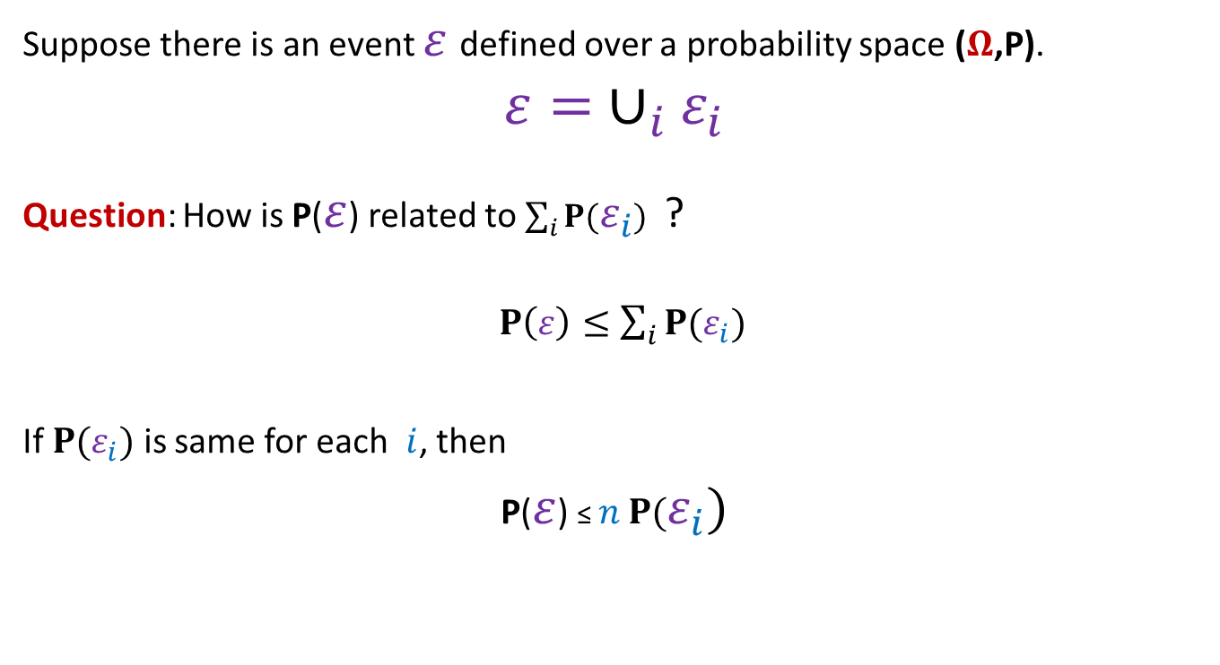
Probability tool (union theorem)
Suppose there is an event $ε$defined over a probability space ($Ω$,P).
$$ε= ∪_{i}ε_{i}$$
Question: How is P($ε$) related to $\sum_{i}{P(ε_{i}})$ ?
$P\left(ε\right)≤\sum_{i}{P(ε_{i}})$
If $P(ε_{i})$ is same for each $i$, then
P($ε$) ≤ $n$ $P(ε_{i})$

Slide 30

Homework
Make sincere attempt to show that the maximum load on any server
will be O(log $n$) with high probabilility.
Hint: Use Union Theorem.

